Slide 1

Personalize your Flat
Because travelling is the only thing you buy that makes you richer...

Slide 2
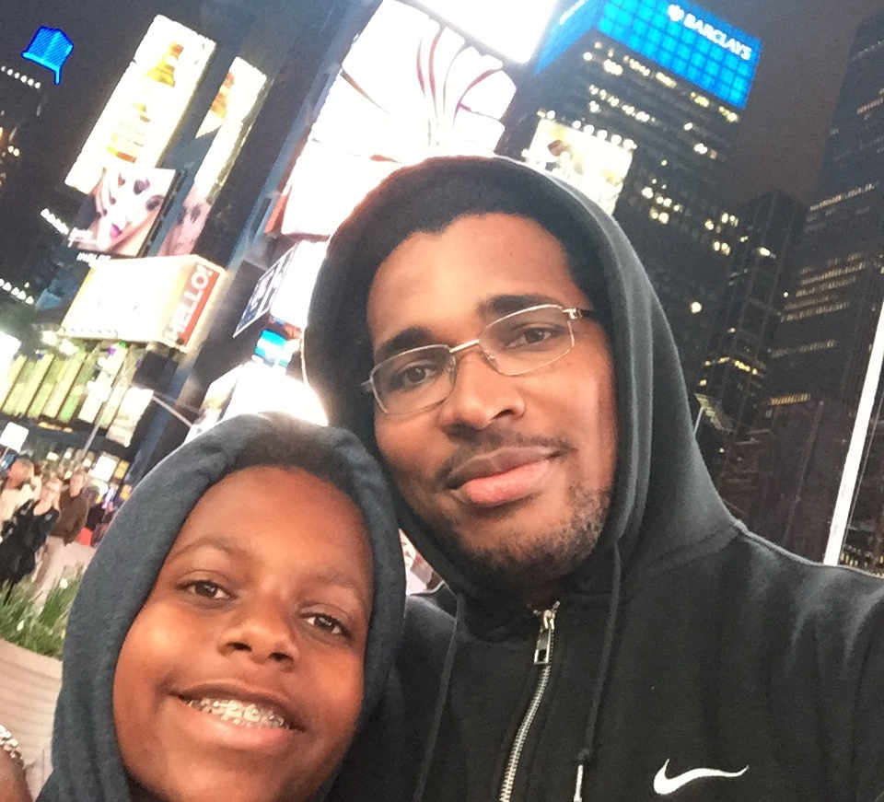
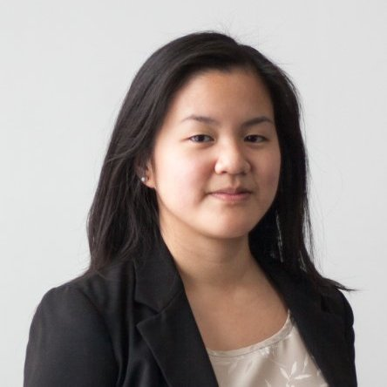
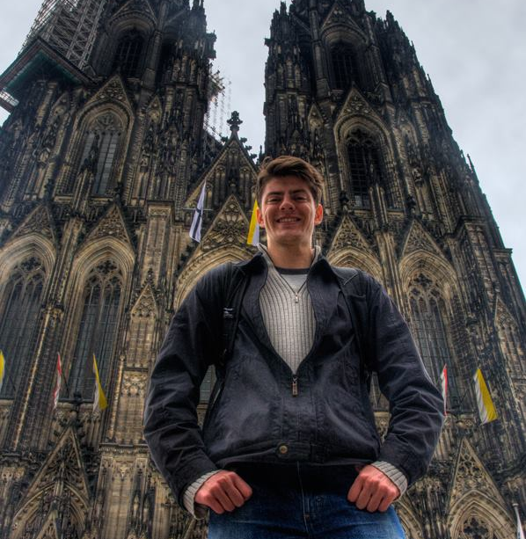
The Team
Yannick Jacques
iOS Developer
Avid video gamer
@donrakes
www.zytix.com
Kim Sang Ly
Full-Stack Developer Amateur photographer
@lykims
Eduard Olteanu
Software Developer
Traveller
@EdOlteanu

Slide 3
Inspiration
As Flatbook attempts to offer the best of Airbnb and hotels, we thought of what was missing in this approach.
The scope was to be as close as possible to the customer through their journey and offer any services they might be missing.
We are trying to be proactive in our approach and make sure the experience is fantastic from the very beginning.

Slide 4




Technology
Swift
Firebase
HTML5/CSS/JS
Bootstrap

Slide 5
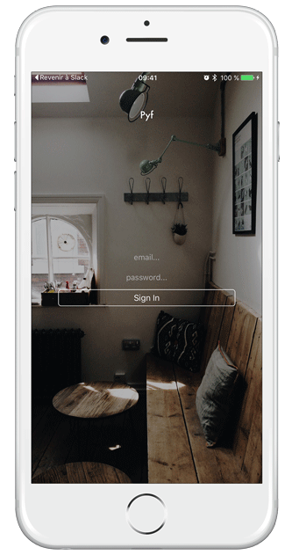
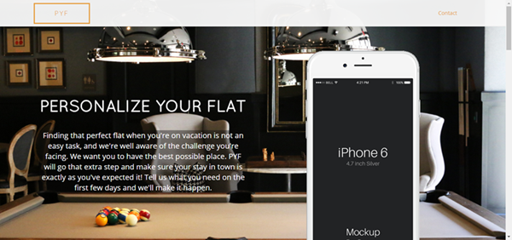
results
Website
Application

Slide 6




Extensions
As the potential use of this application is non negligible, we thought of adding the following to our current project:
An internal web interface to receive and process requests from customers
WordPress/Planyo
A web interface offering similar possibilities as the iOS app
Javascript/Firebase
An Android app

Slide 7
Q & A

